Slide 1

Our approach to Hardware prototyping for IoT use cases
Thomas Delissen, Vienna, 27-11-2017

Slide 2
Goal of this slidedeck
IoT at Capgemini
What do we mean with IoT?
General Use Case pattern for IoT
Prototyping a device for IoT

Slide 3
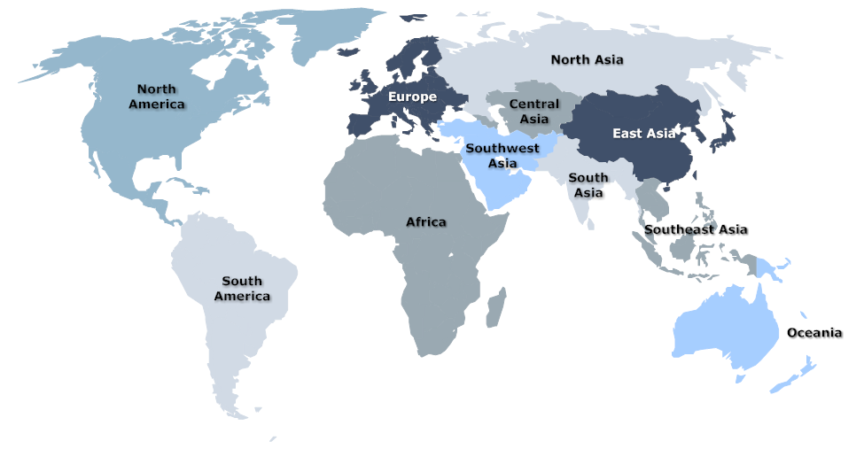
Capgemini IoT Global Practices
iGate
Atlanta
SES
Ontario
Sogeti
Toulouse
I&D
Paris
SHT
Utrecht
DCA
Amsterdam
CC
Stockholm
DCX
Hamburg
iGate (Sensors, Embedded Sogftware)
Shamik Dasgupta
SES (Energy)
Perry Stoneman, William Nicholson
Mike Malloni
Sogeti (M2M, Embedded Software)
Michiel Boreel, Philippe Ravix
Menno van Doorn
SHT (Sensors)
Carlos Rebeiro
DCA (Infrastrutkur)
Ab Frohwein, Edwin Leinse
CC (Strategy)
Johann Williamson
DCX (CSX)
Michael Capone, Jan Gudat
Chrome (Manufacturing)
Mangirish Hervadkar, Saktipada Maity
iGate (Sensors, Embedded Software)
Madhusudhan Reddy Nukala Shreyas Bhargave, Bipin Patwardhan
GES (Sensors)
Uday Gokhale, Aditya Gondhalekar
Insights & Data (Analytics)
Jean Gillot
Slide from June 2017
iGate
Mumbai
GES
Bangalore
ChromeKolkata

Slide 4






Capgemini has done IoT projects in many sectors
Utilities
Retail
Finance
Insurance
Manufacturing
Water management

Slide 5





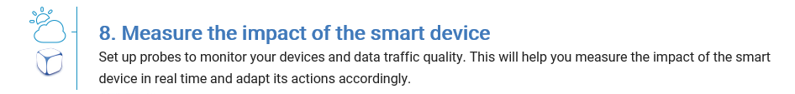
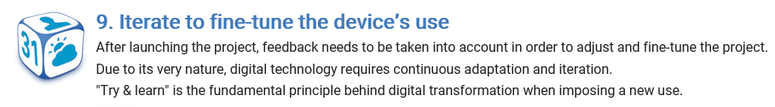
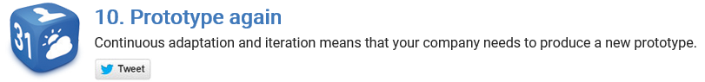
Capgemini has extensive experience in the IoT arena
See the dedicated IoT site from Capgemini, containing several articles and our approach for monetizing IoT:
https://more.capgemini.com/beyond-the-buzz/monetizing-internet-of-things/
Contains a 10 step plan to do IoT: This presentation focuses on steps 3 - 6, and provides a practical approach on how to setup your ‚Thing‘.
Capgemini Internal: There is also the German IoT community, we are part of: https://km3.capgemini.com/community/1050485

Slide 6
What do we mean with IoT? Let us start with explaining: ‚Things‘
Sensor
‚Things‘ we are talking about usually devices that can have inputs, outputs and some way of transforming inputs into outputs
Device
Actuator

Slide 7
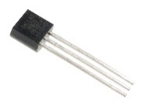
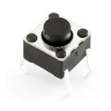
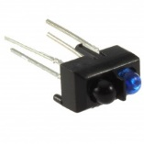
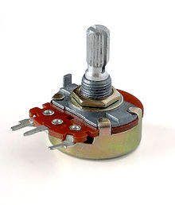
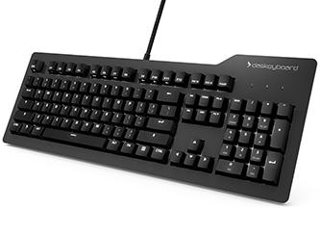
What are sensors?
Sensor
Sensors are all devices that can provide input to a device. Examples:
Temperature-sensor
Infra-red sensor
Buttons
Potentiometers (turn-buttons)
But also:
Keyboard
Mouse
Wifi-receiver
Device
Actuator

Slide 8
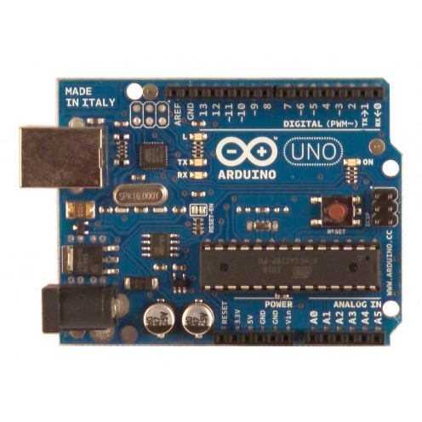
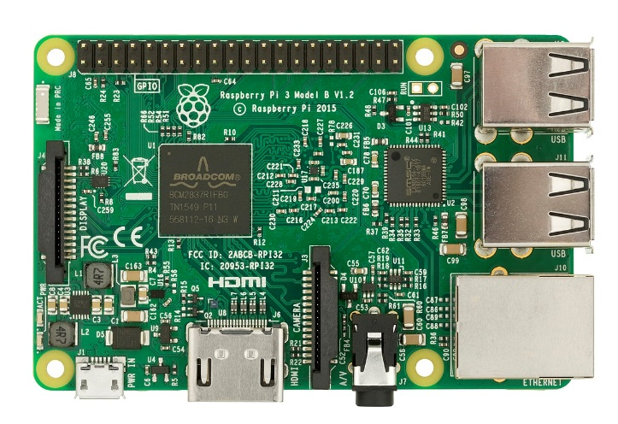
What do we mean with Devices?
Sensor
Devices can be anything, really. But for hardware prototyping, it is usually a microcontroller, like an Arduino Uno or Raspberry Pi
Devices:
Microcontroller
Actuator
Arduino Uno
Raspberri Pi

Slide 9
What do we mean with Actuators?
Sensor
Actuators are things that do something based on a signal from the Devices, so the Output-devices:
Lights / LEDs
Speakers
Motors
LCD displays
But also:
Monitors
Wifi transmitters
Devices:
Microcontroller
Actuator

Slide 10
You can hook up the devices mentioned to the internet!
Sensors
Internet
By using (for example) a Wifi-transmitter and receiver.
At this stage, you have a ‚connected Device‘ or a single ‚IoT Device‘
Now, we define the Internet of Things:
Internet
+
connected IoT Devices
Devices:
Microcontroller
Wifi transmitter / receiver
Wifi-router
Wifi signal

Slide 11
General use case pattern for IoT
IoT Device

Slide 12
Some observations regarding IoT use cases
1. IoT Devices generate large amounts of data
2. Usually we expect customers to have a large amount of IoT Devices
3. This results in a huge data set being generated (Big Data)
4. In order to do useful things with this data, we apply advanced analytics, such as Machine Learning algorithms
5. With machine learning, we create Predictive Models, that can provide valuable insights for customers
6. These predictions can furthermore provide value to the customer in knowledge systems, and can be used to take action upon

Slide 13
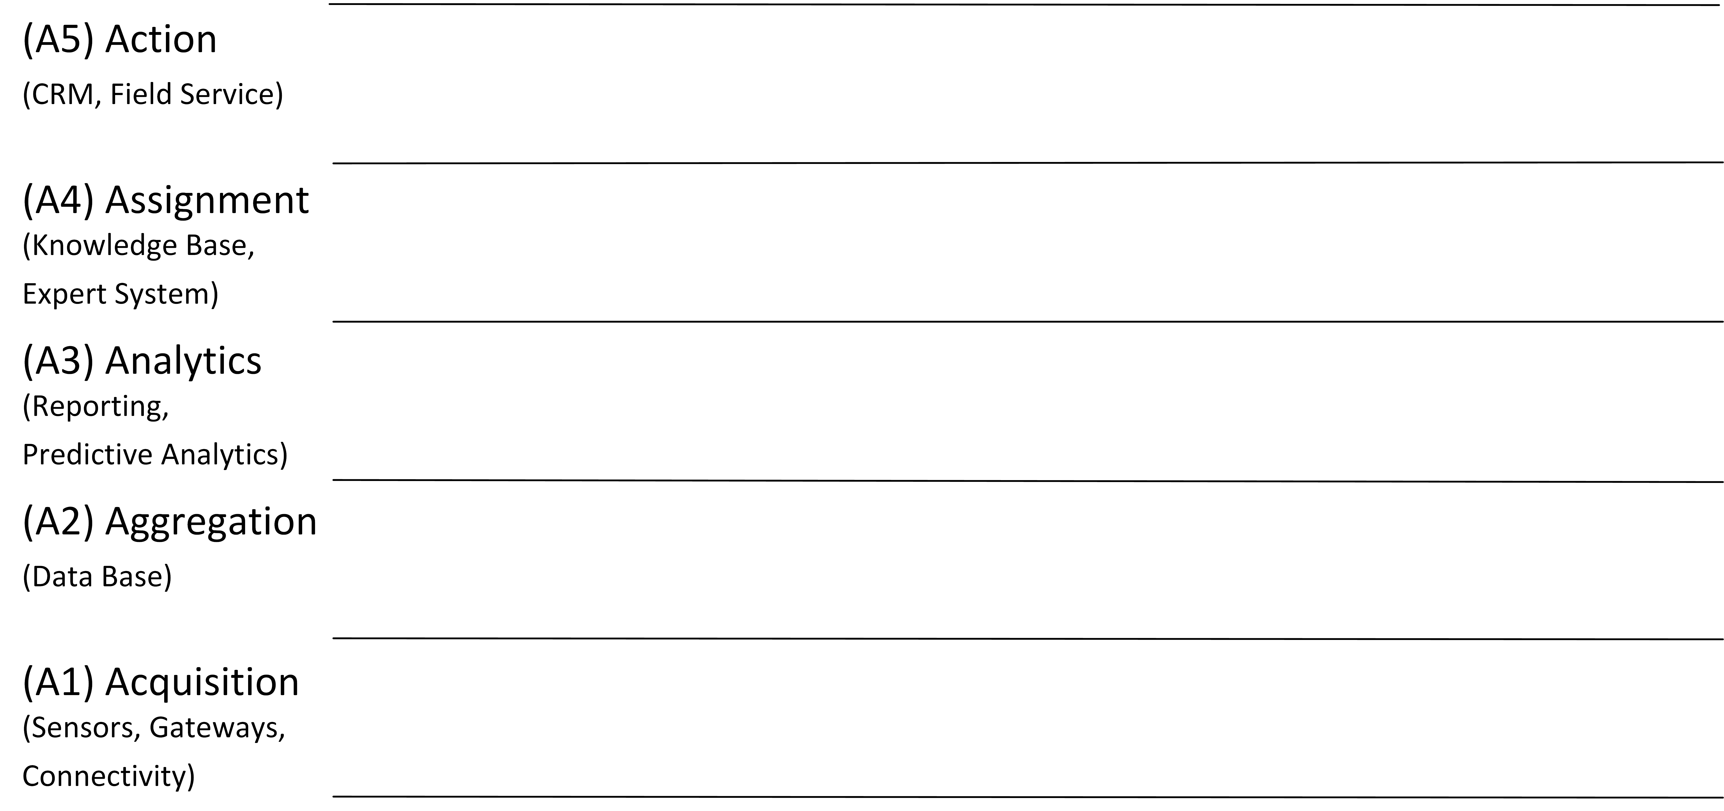
Use Cases: method/approach, meta information, clustering (slide from IoT-Community_Use-Cases-Overview)
Clustering – Integration in 5A Model
Remote Control
Optimized resource consumption
(automated) Process optimization
Complex autonomous systems
(sensor-driven) decision analytics
Enhanced situational awareness
Tracking behavior
Connectivity (no business benefit)
Source 5A Model: Capone, 2016.
Source Use Case Cluster: in relation to Chui, 2010.
Notes:
Use Case cluster sorted in the 5A model

Slide 14
So IoT is not just about the device!
It is about what we do with the data we get out of it, that creates the most business value.
That said, this slidedeck is about showing you how to build a prototype device using Arduino ☺

Slide 15
Prototyping a device for IoT
Using Arduino

Slide 16
Hello world:
Connecting to the Arduino UNO

Slide 17
Some remarks up front
In this tutorial we use Arduino Uno.
You could also do prototyping with Raspberry Pi, which in some use cases may be easier.
Depending on your knowledge, you can use either technology.
My gut feeling: Arduino is better if the prototype is ‚hardware‘-heavy, Raspberry Pi is better with connectivity to internet.

Slide 18
Some Usefull links
There are a lot of tutorials and tools out there that can help you get started, so you can also look there, instead of in this tutorial:
https://www.arduino.cc/en/Tutorial/HomePage
Also in German:
http://www.arduino-tutorial.de/
A tool (that is still under construction) for creating circuit diagrams and simulating them:
www.tinkercad.com
Also, there is a CD with the Sensorkit, that contains example code and circuits for each sensor.

Slide 19
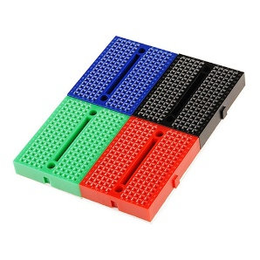
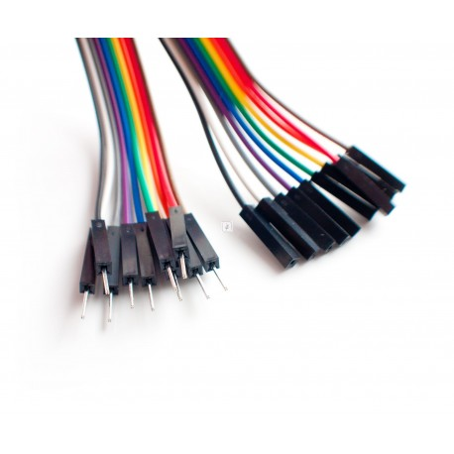
You need the following items for this tutorial:
1 Arduino Uno
1 USB to Micro-USB cable
1 Laptop to do the programming on
(I assume a Windows laptop)
1 Infrared sensor
1 Infrared transmitter
2 Breadboards →
Maybe some Resistors
Jumper cables (male-male; female-female)

Slide 20
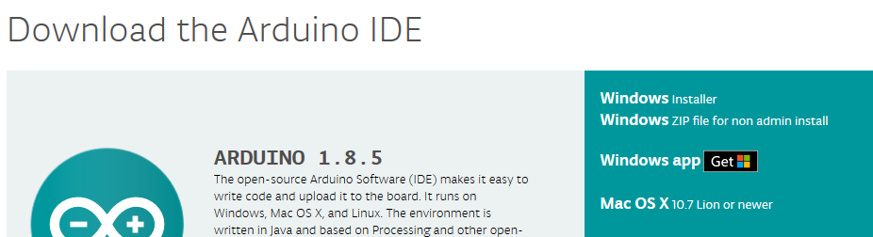
Connecting to the Uno
This is your Arduino Uno.
Before connecting it to your laptop, you need to install the proper software.
Go on your laptop to:
https://www.arduino.cc/en/Main/Software
Go to ‚Download the Arduino IDE‘, and click Windows installer:
These are input/output (I/O) pins. You use these to connect to the sensors
Micro-USB connector, this is how you attach it to your laptop
This is the actual processor chip, may look different (smaller) in your version
Power connector

Slide 21
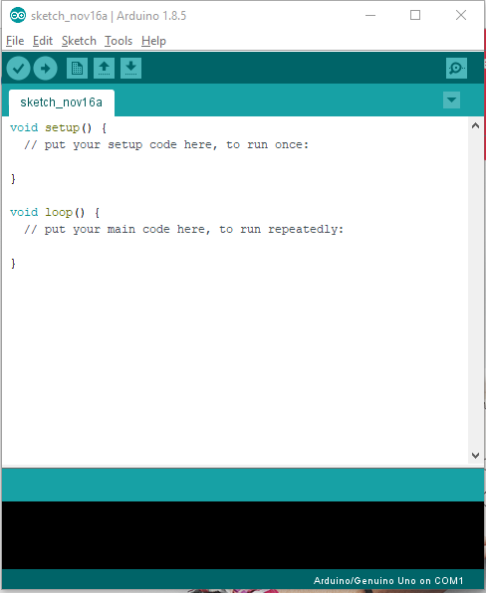
Connecting to the Uno
After installing the Uno IDE, you can start the application
It shows you a ‚sketch‘, which is basically a script you can run on an Arduino.
You program the code on your laptop
You deploy the code to the Arduino, which then runs the code continuously.
Code in the Setup is run only once
Code in the loop will continuously loop, until you turn the device off

Slide 22
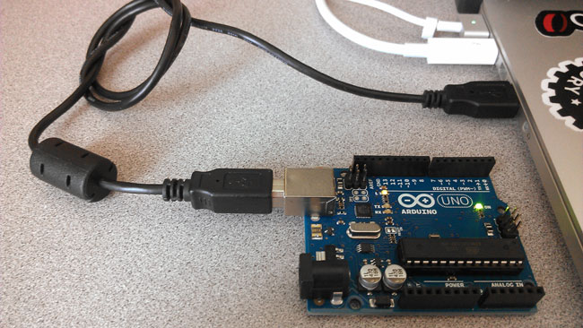
Connecting to the Uno
Now, plug the arduino into your laptop via the USB-cable.
Some lights should start blinking. It could be that windows installs some drivers now.
To test if the Arduino works properly, we will run a standard script to test with a LED light

Slide 23
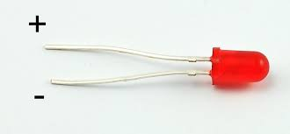
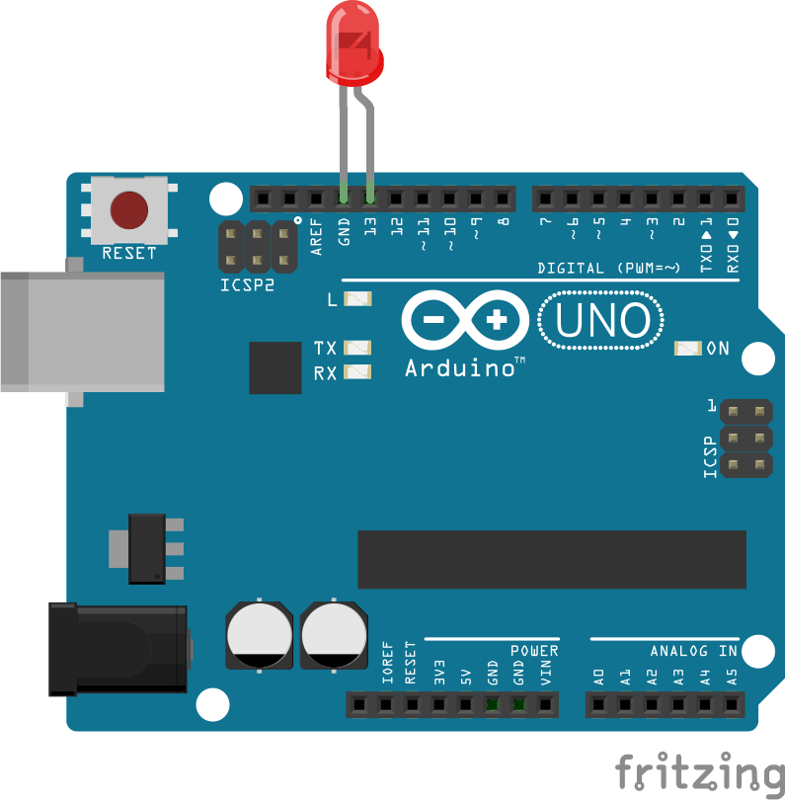
Connecting to the Uno
This is a LED:
They come in different colors.
LEDs only allow current to flow in 1 direction, this is why it is important that you plug it in the right way.
→ The long leg is always the Positive pin
BEFORE PLUGGING the led in, remove the USB Cable: Best to not change the circuit when it is plugged in.
→ Plug the LED into your arduino as shown in the picture. + goes into pin 13, - to the ground.

Slide 24
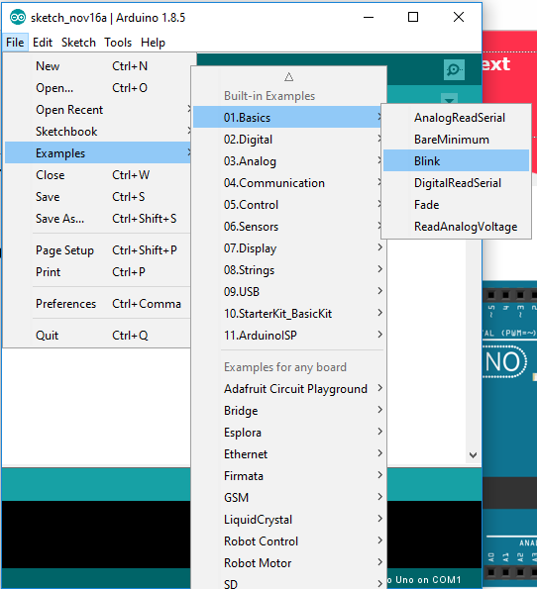
Connecting to the Uno
Now, reconnect the Uno to your laptop over the USB cable.
We will now load a standard sketch onto the Arduino.
In the Sketch you have just opened, go to:
File > Examples > 01.Basics > Blink
It will open a new window, see next page.

Slide 25
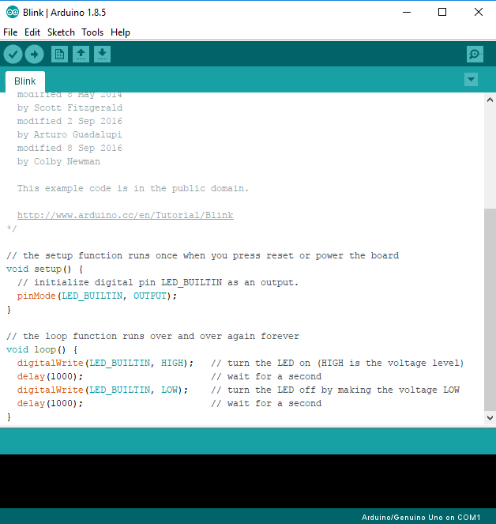
Connecting to the Uno
If you scroll down in the Blink sketch, you will see some simple example code.
(this is written in C++, by the way)
If you want to learn the language, go to:
https://www.arduino.cc/reference/en/
For now, you can also just copy paste code from the examples, and modify them.
This code will blink the ‚build in LED‘, which is also connected to pin 13. This is why the LED we just added will also blink.
Alternatively, you could change LED_BUILTIN by ‚13‘ everywhere, to get the same result.

Slide 26
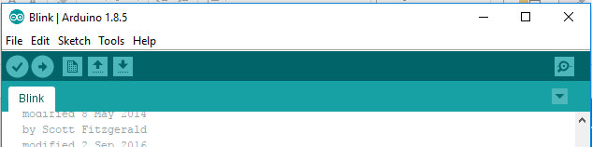
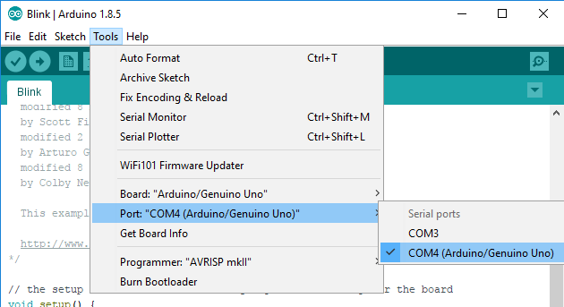
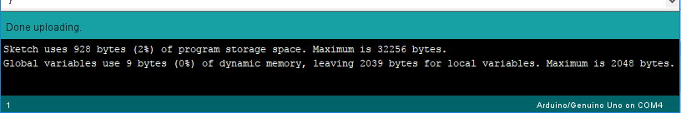
Connecting to the Uno
Deploy button
To deploy the code to the Arduino, click the deploy button.
This will validate and compile the code, and push it to the Arduino.
You may get errors, maybe the sketch cannot find the board yet. Try this:
Tools > Port > [select port that has Arduino in it]
If all goes well, the LED will start blinking, and you will see in the console:

Slide 27
Well done!
Now you know the bare minimum to work with Arduino Uno.
You can now start doing online tutorials such as on:
https://www.arduino.cc/en/Tutorial/HomePage
Or if you prefer German:
http://www.arduino-tutorial.de/einfuhrung/
When you unplug the Arduino, the sketch will still be there. It will automatically start running the next time you plug in the Arduino. It is sometimes smart to put a ‚safe‘ sketch on it (like Blink) when you put away your Arduino, so that it doesn‘t do weird things when you connect to it after a few months ☺

Slide 28
Connecting the IR sensor and IR Receiver to Arduino Uno

Slide 29
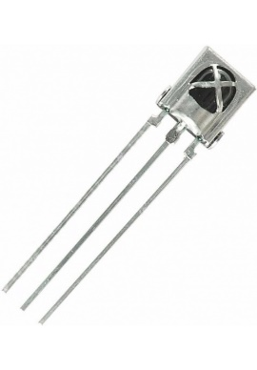
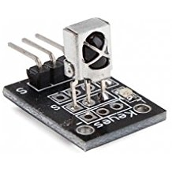
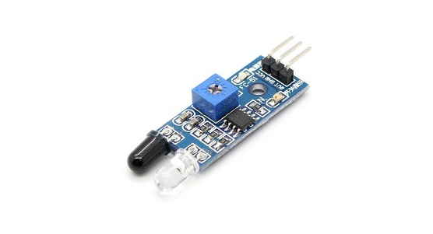
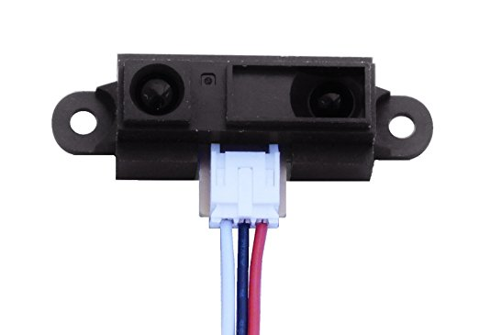
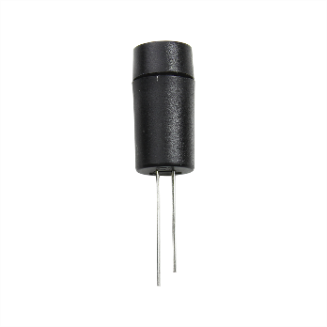
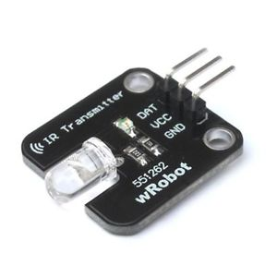
Connecting the IR sensor and IR Receiver to Arduino Uno
This section will show you how to use a IR sensor and IR receiver.
There are multiple IR sensors and receivers on the market, so it could be that yours looks different from the one we will use.
Try to google the one you got, to see if the specs match what we want to do with it.
Basic sensor
Basic sensor including resistors
Light comes out here
Combined transmitter and receiver module
Basic (shielded) transmitter
Basic transmitter including resistors

Slide 30
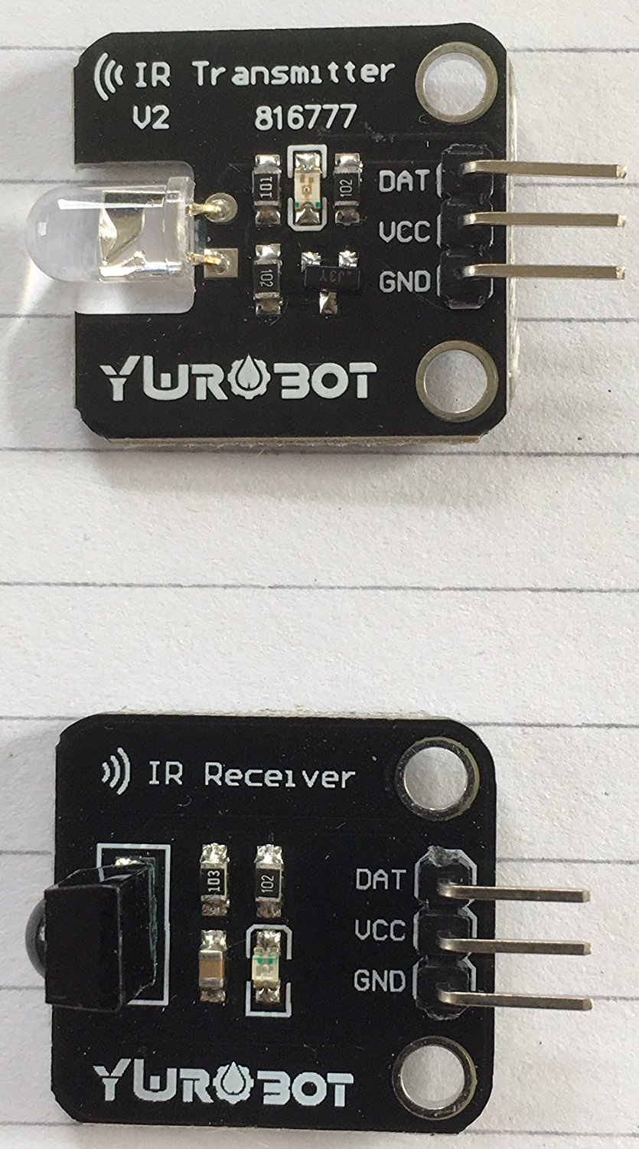
Connecting the IR sensor and IR Receiver to Arduino Uno
The pins are labeled:
DAT: Here you should send the signal to
VCC: Here you connect the 5 volt power line
GND: Here you connect the Ground.
DAT: This returns a signal dependent on IR light sensed
VCC: Here you connect the 5 volt power line
GND: Here you connect the Ground.
We assume now you have the basic sensors including the resistors, as shown here. If you have different ones, you may have to adapt your circuit to include resistors.
The top one is the transmitter, the bottom one the receiver.
When the sensor sees IR light, its resistance increases, more power goes to the signal pin

Slide 31
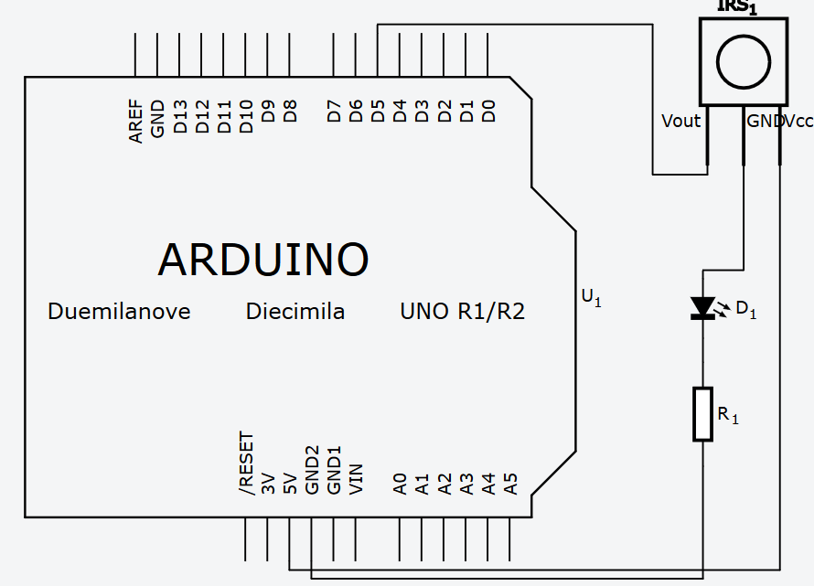
Connecting the IR sensor and IR Receiver to Arduino Uno
First we will connect the IR receiver, and test it.
Connect the IR receiver as in the diagram in the right.
D1: LED light.
R1: Resistor
This setup will reduce the light emitted by the LED when the IR receiver receives IR light

Slide 32
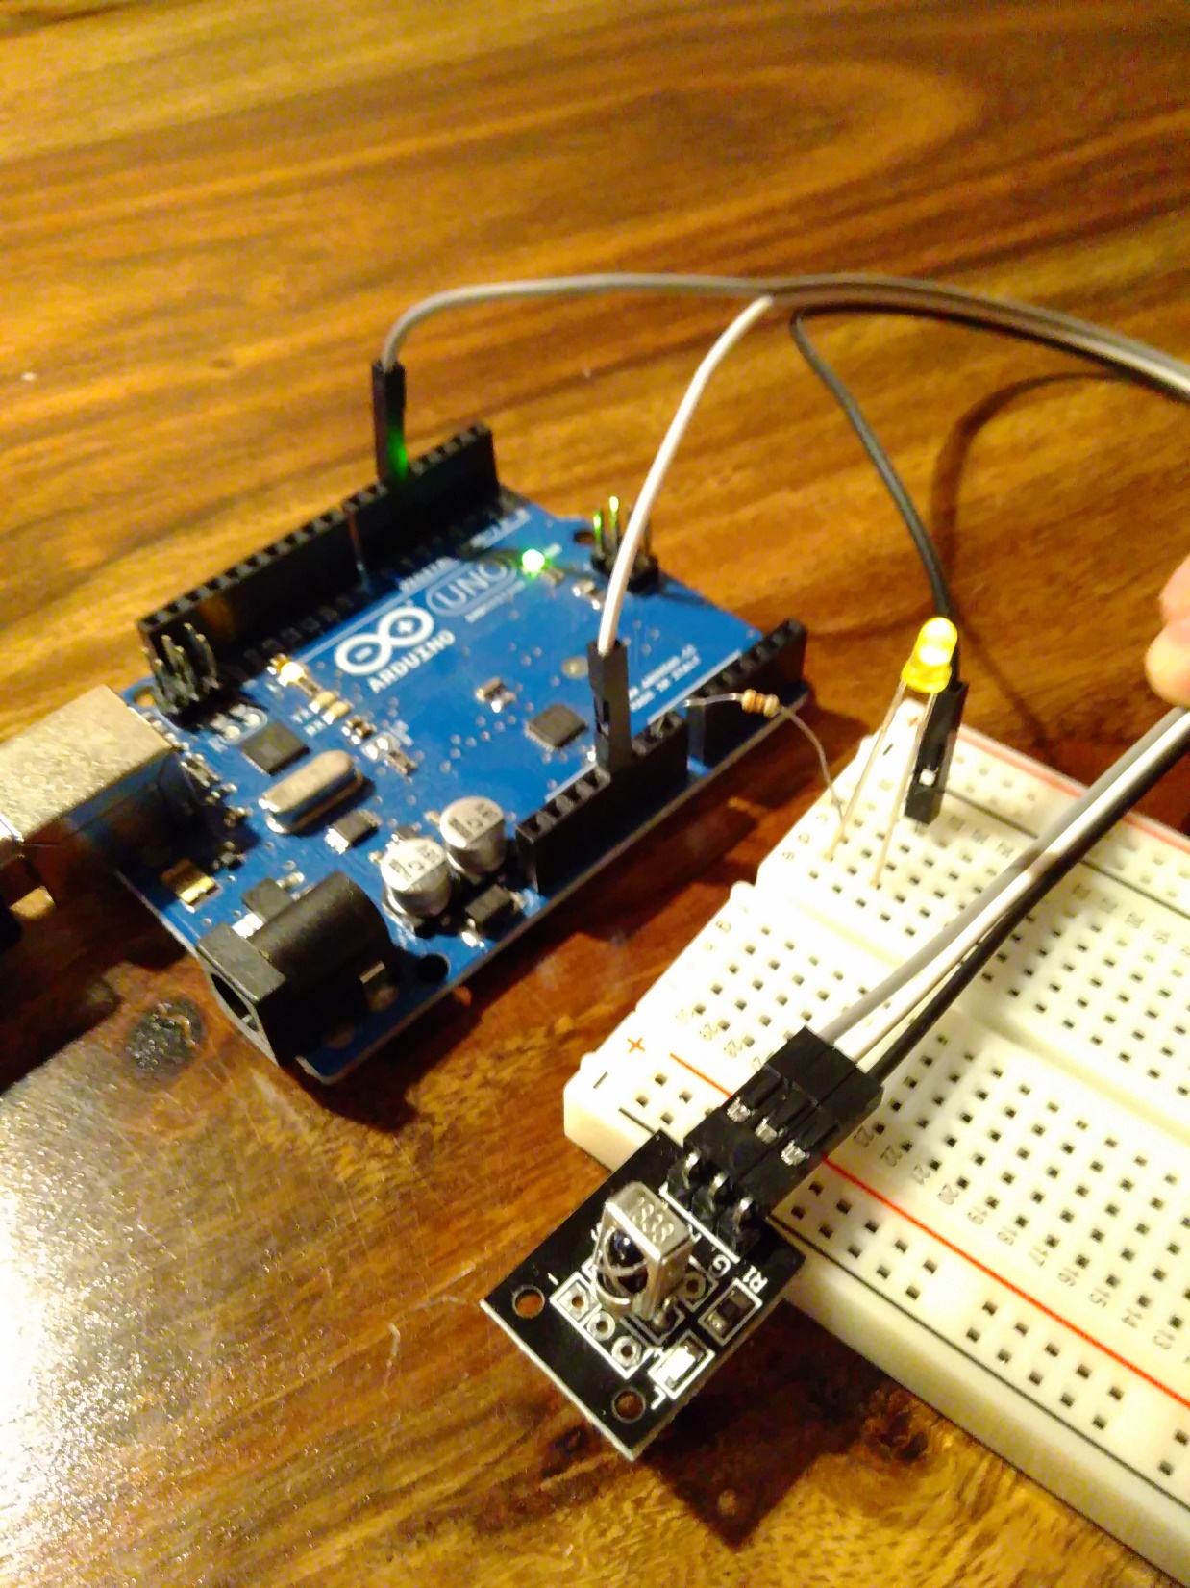
Connecting the IR sensor and IR Receiver to Arduino Uno
Here is a sample of how to build the circuit in practice.
We used ‚male – female‘ wires to connect the IR chip here, but you could also have plugged it on the breadboard and used ‚male – male‘ wires.
Male
Female

Slide 33
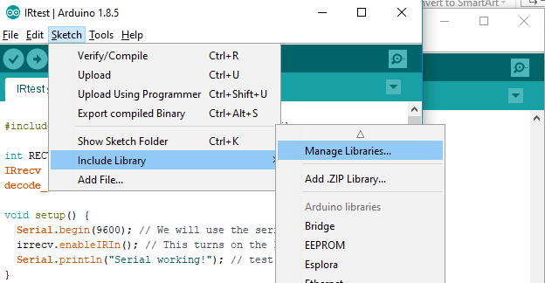
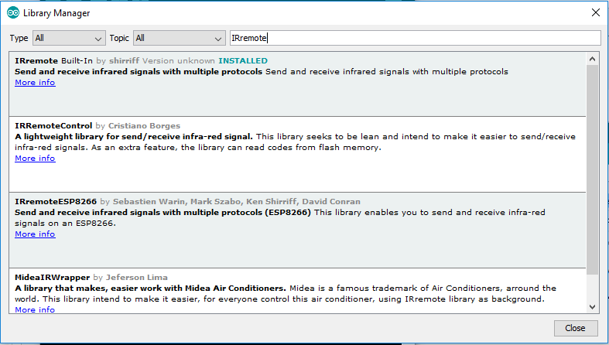
Connecting the IR sensor and IR Receiver to Arduino Uno
Once you have created the circuit, we will add code to show you the IR signals it receives on the
Serial Monitor.
First we need to download the right ‚library‘ to use infrared as shown right: this should make it easier.
First go to Manage libraries:
Type IRremote in the search field
Select and install the first library

Slide 34
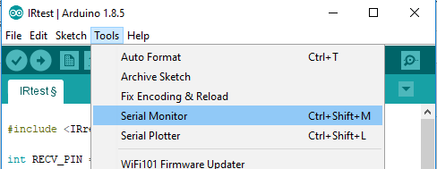
Connecting the IR sensor and IR Receiver to Arduino Uno
#include <IRremote.h> // first install this library
int RECV_PIN = 5; // Signal pin
IRrecv irrecv(RECV_PIN); //to setup the Pin as a IR receiver
decode_results results; //this will store results from IR code
void setup() {
Serial.begin(9600); // We will use the serial connection to output info (serial monitor)
irrecv.enableIRIn(); // This turns on the IR receiver code
Serial.println("Serial working!"); // test if the serial monitor works
}
void loop() {
if (irrecv.decode(&results)) { // every time a signal is decoded, do this:
Serial.println("signal received: ");
Serial.println(results.value, HEX);
irrecv.resume(); // this makes sure the IR code listens for new signals
}
}
Now, we can build a sketch to test the signals we receive.
The goal of this sketch is to capture any IR signals and write them to the ‚Serial Monitor‘.
Copy the code on the right into a new sketch.
Then Open the serial monitor:
Tools > Serial Monitor

Slide 35
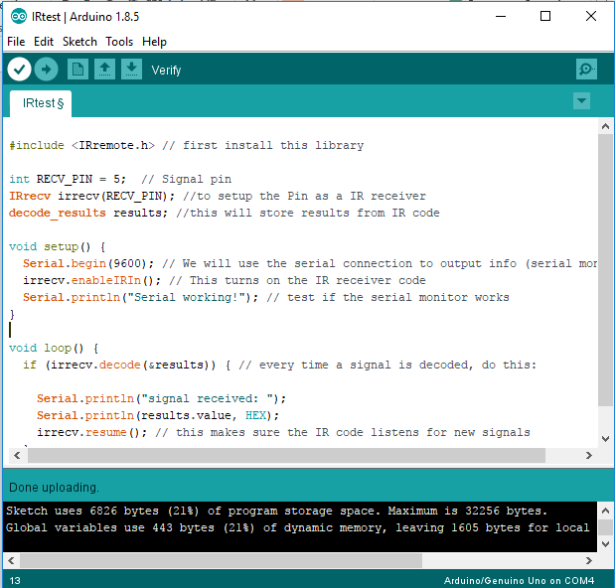
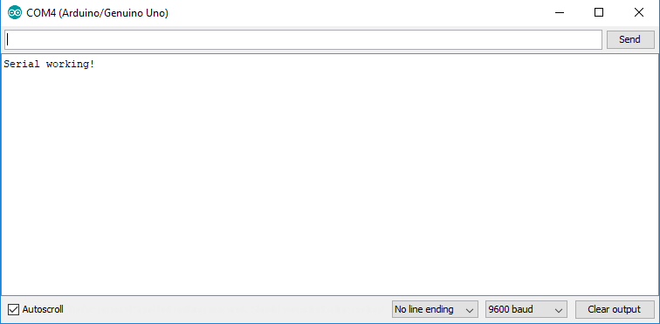
Connecting the IR sensor and IR Receiver to Arduino Uno
Compile and update
Now, connect the arduino to your laptop and deploy the code.
Sometimes it fails just after plugging the arduino in; in that case, try again.
If you keep having issues, try googling the error message.
Otherwise, you should see this in the Serial monitor:

Slide 36
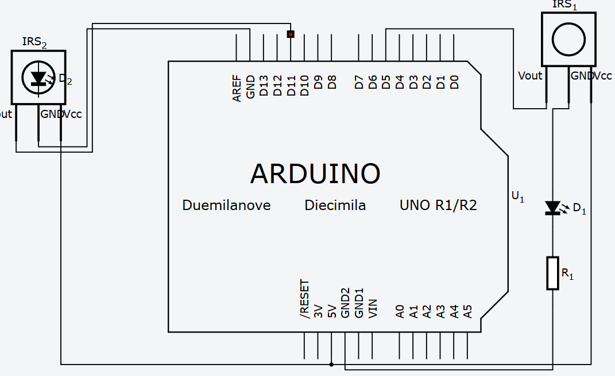
Connecting the IR sensor and IR Receiver to Arduino Uno
Next step is connecting the transmitter. We will use the same Arduino for that, leave the receiver plugged in as well, and adapt the code.
First, unplug the arduino from the USB and attach the transmitter to the Board as follows. The thing on the left is representing the IR transmitter.
If you can‘t add it to 5v, you can also add it to 3v, will also work.

Slide 37
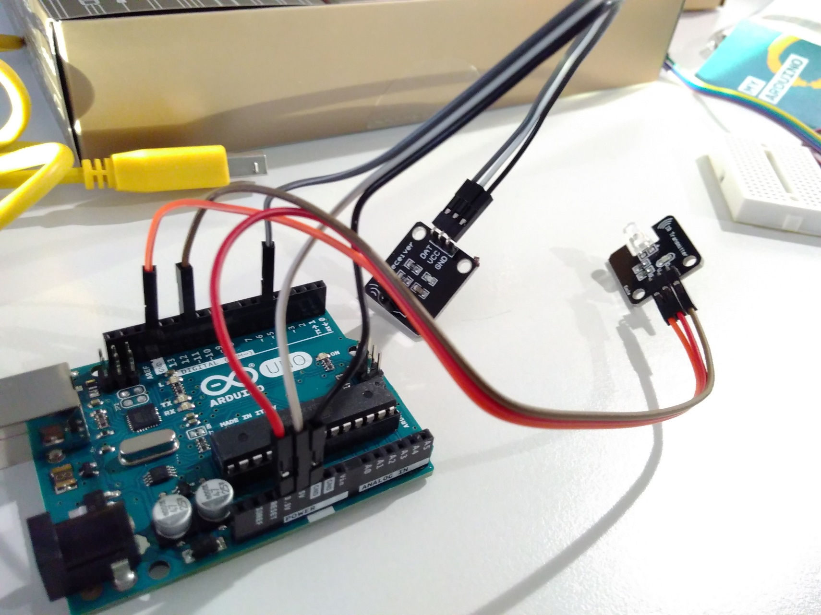
Connecting the IR sensor and IR Receiver to Arduino Uno
Now, after adding the Receiver, it should look something like the picture here.
In this setup the LED and resistor of the IR-sensor are removed, since they are already on the chip.

Slide 38
Connecting the IR sensor and IR Receiver to Arduino Uno
#include <IRremote.h> // first install this library
int RECV_PIN = 5; // Signal pin receiver
int SEND_PIN = 11; // Signal pin transmitter
IRrecv irrecv(RECV_PIN); //to setup the Pin as a IR receiver
decode_results results; //this will store results from IR code
void setup() {
// Code for receiver
Serial.begin(9600); // We will use the serial connection to output info (serial monitor)
irrecv.enableIRIn(); // This turns on the IR receiver code
Serial.println("Serial working!"); // test if the serial monitor works
// Code for sender
pinMode(SEND_PIN, OUTPUT); // setting the sender pin
}
void loop() {
// Code for receiver
if (irrecv.decode(&results)) { // every time a signal is decoded, do this:
Serial.println("signal received: ");
Serial.println(results.value, HEX);
irrecv.resume(); // this makes sure the IR code listens for new signals
}
// Code for transmitter
IR_Send38KHZ(280,1);
IR_Send38KHZ(140,0);
delay(200);
}
// This is a standard library function you can just use
void IR_Send38KHZ(int x,int y)
{
for(int i=0;i<x;i++)//15=386US
{
if(y==1)
{
digitalWrite(SEND_PIN,1);
delayMicroseconds(9);
digitalWrite(SEND_PIN,0);
delayMicroseconds(9);
}
else
{
digitalWrite(SEND_PIN,0);
delayMicroseconds(20);
}
}
}
Now, we can send signals to the IR transmitter over PIN 11.
The following code makes sure to send out a 38Khz signal every few milliseconds, which can be seen by the receiver. It is integrated with the code for the receiver.
You can copy paste this into your sketch.

Slide 39
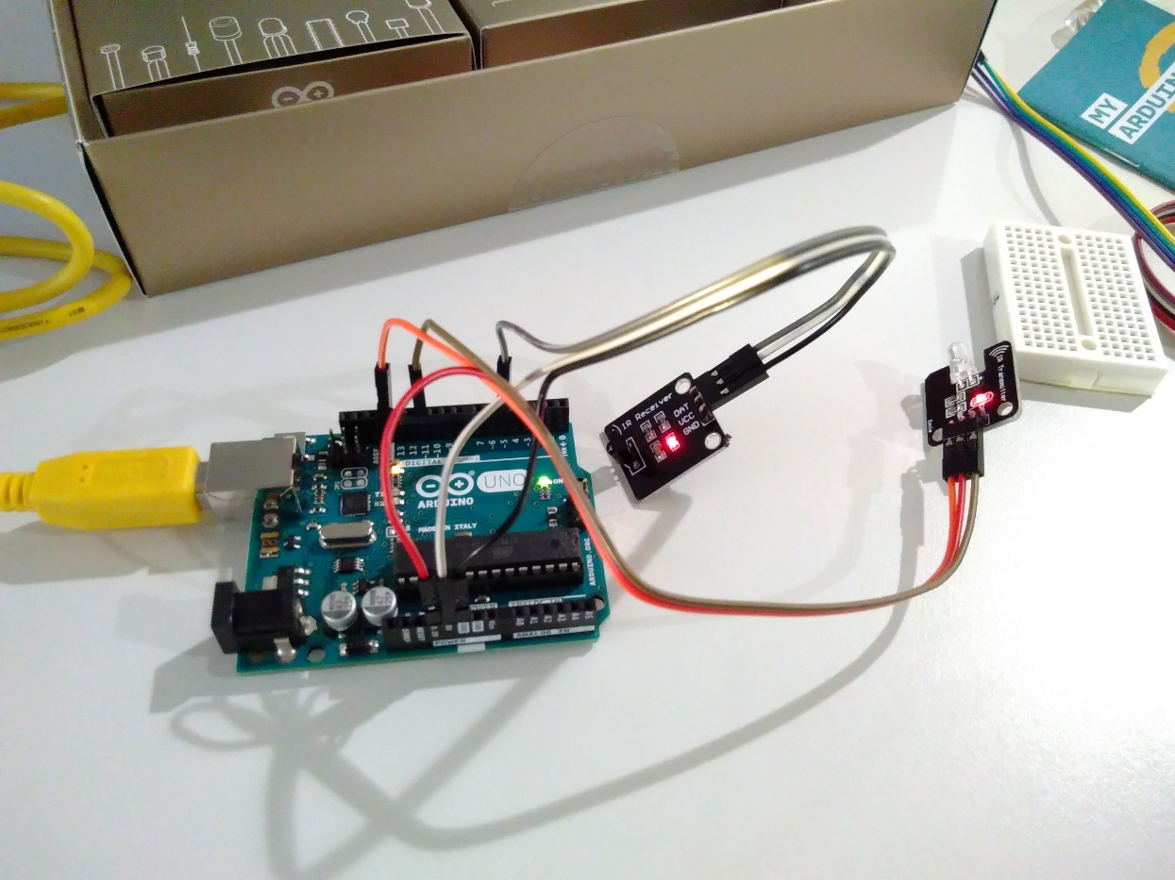
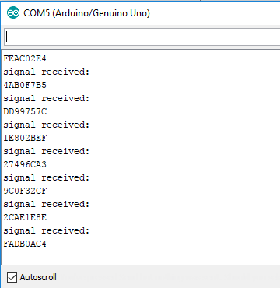
Connecting the IR sensor and IR Receiver to Arduino Uno
Now, deploy the code to the circuit you build, and the IR sender and Receiver should work!
If they have built in LEDs, they should light.
Also, you should see messages such as this in the Serial Monitor:
In case we were sending actual ‚signals‘, we could decode them now, although currently we are just sending IR ‚light‘.

Slide 40
That‘s it, you build your first prototype!
For more info, contact: Thomas.delissen@capgemini.com

